Slide 1
Announcements
Schedule:
  Th 2/27: Finish Treatments + Review for Exam 1 (if time)
  Tu 3/3: Exam 1 → Covers Ch 5, 6, 10, + Thernstrom & Lecture
I am working on feedback for Survivor Questions… Should be done by tomorrow
In case you’re scared you’re leaving something important out, here’s my list of topics to consider:
In addition to asking about the person's experience and coping strategies, I'd suggest asking about some of the specific topics from class, such as immediate responses to stress (fight, flight, fright, tend and befriend, whether they felt the experience made them more likely to get sick in the aftermath, coping strategies, access to social support and its value, personality (optimism, hostility, conscientiousness, etc.), resources, and whether anything good came out of the experience or they have advice for others (post traumatic growth).

Slide 2
* Stress & Coping Exam *
Exam 1 is Tuesday 3/3!
  Covers Ch 5, 6, 10, + Thernstrom & Lecture
  4 short answer questions worth 10 pts each
  30 MC questions worth 2 pts each
  ~3 potential bonus points
Advice:
  In the textbook, focus on key terms in boldface or italics
  For key terms in lecture and/or the textbook, ask:
    Can you define this term? Can you give an example? Can you recognize an example?
  You need to know “big names” from lecture, but NO DATES
    Big names from theories = Cannon, Taylor, Selye, Lazarus & Folkman…
    Big names from major studies = Sheldon Cohen, Janice Kiecolt-Glazer…any study that has an entire slide devoted to it – can you recognize why it was done and what was found?
Email me with questions or to schedule a meeting
Example questions are in the 2/25/20 ppts

Slide 3
Treatments for Stress & Pain
2/27/20

Slide 4
Types of Treatments
Medicine / Surgery
Exercise / Physical Therapy
Hypnosis
Complementary & Alternative Medicine
  Massage, Acupuncture, Chiropractic Care, Tai Chi, Yoga
Distraction
Humor
Emotional Expression
Biofeedback
Relaxation Techniques
  “The Restorative Value of Nature”
  Progressive Muscle Relaxation
  Meditation
Systematic Desensitization / Exposure Therapy
Cognitive Behavioral Therapy
3rd Wave techniques
  Mindfulness Meditation
  Guided Imagery

Slide 5


Emotional Expression
Suppressing emotions can be damaging
  Ex: stigmatized identities
Expressing emotions can be beneficial
  Ex: Pennebaker’s writing studies → write for ~20 min / 3-4 days
    We develop a narrative about our traumas and pain, literally
    Putting emo / traumatic experience into writing helps add structure to chaotic, potentially obsessive thoughts
  Of course, expressing hostility can make stress worse

Slide 6
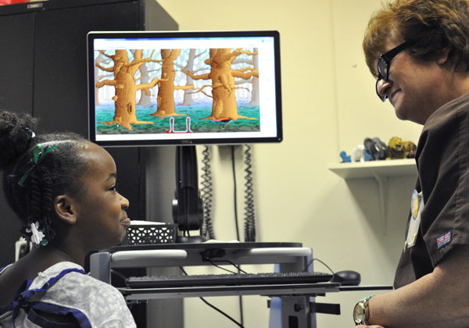
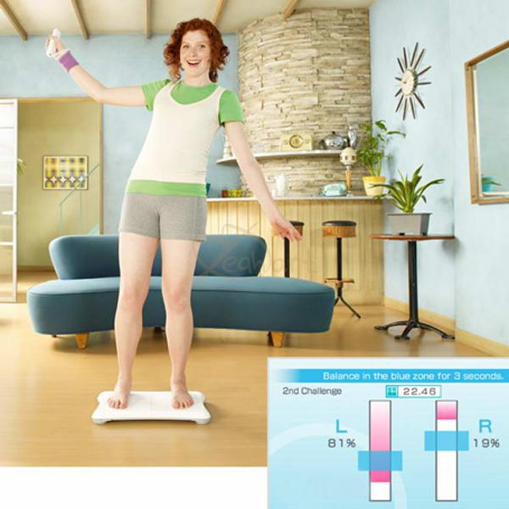
Biofeedback
Biofeedback = process of providing feedback information about the status of a biological system
  Bio responses measured, feedback given immediately so person can see changes as they occur
  Most common test is EMG (electromyograph) → electrodes measure muscle tension, and person can see levels on a screen
      Helps people recognize when they are more tense vs. relaxed
The Wii Fit used biofeedback to help people improve their balance by seeing visual indicators as they changed posture
https://www.umc.edu/news/News_Articles/2015/December/Testing--biofeedback-make-UMMC-pediatric-GI-program-rare-in-region.html

Slide 7
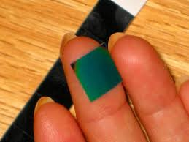
Put your stress square on your finger tip OR press your finger on the square:
Stress Square
Hold your finger on the square for 10 seconds to measure your stress level
Black = Tense ~79°
Red = Nervous ~84°
Green = Calm ~87°
Blue = Relaxed ~91°

Slide 8
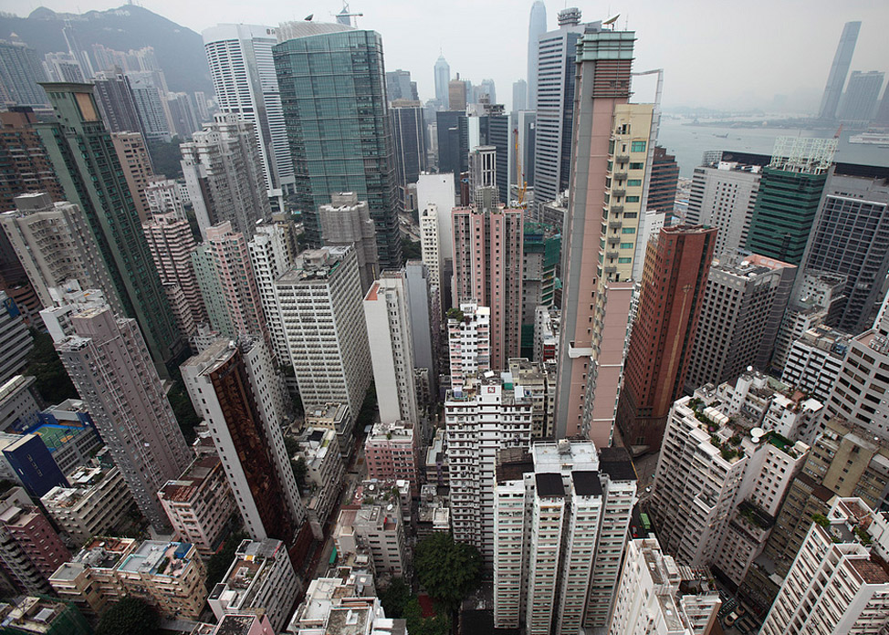

“The restorative value of nature”
  Being deprived of natural scenes causes stress
https://www.youtube.com/watch?v=tCn1LzOk6Hs

Slide 9
Put your stress square on your finger tip OR press your finger on the square:
Stress Square
Hold your finger on the square for 10 seconds to measure your stress level
Black = Tense ~79°
Red = Nervous ~84°
Green = Calm ~87°
Blue = Relaxed ~91°

Slide 10

Less controversial mental techniques
Relaxation training – may be key ingredient to other treatments
  1930s – Progressive muscle relaxation
      Deep breathing
      Muscle tensing & relaxing
      Demonstration
  1970s – Meditative relaxation
    Combines quiet environment with repetitive sound and passive attitude
    Focus on breathing and a mantra or sound (Om)
    Supposed to prevent distracting thoughts
PMR is often used as a tool in systematic desensitization to treat anxiety
Ex: fear of flying
http://prtl.uhcl.edu/portal/page/portal/COS/Self_Help_and_Handouts/Files_and_Documents/Progressive%20Muscle%20Relaxation.pdf

Slide 11
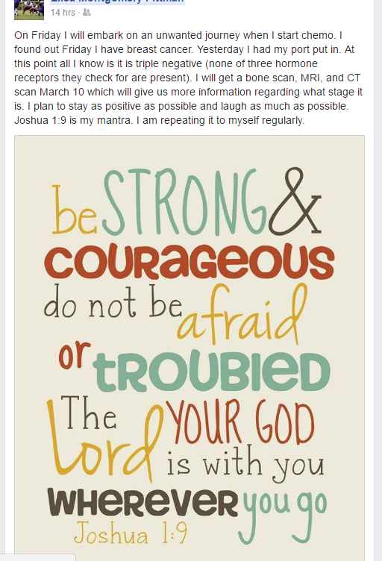
My friend posted this on fb – shows a real-life example of using a religious mantra to focus attention to cope with an overwhelming stressor

Slide 12
Relaxation Training
Evidence:
  Research shows it’s more beneficial than a placebo for treating stress
    Studied in many populations: adults, college students, children
  Often used as part of other interventions
  May work through stress reduction, enhanced perception of control & reduced muscle tension

Slide 13
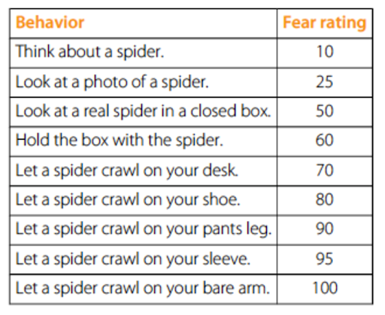
Systematic Desensitization & Exposure Therapy
A treatment for phobias, & PTSD in which patients learn to approach sources of anxiety-provoking stimuli progressively
  Construct an anxiety hierarchy of increasing
  proximity to the stimulus
  Patients learn relaxation techniques to use while
  increasing exposure to the stimulus
  Goal is to learn to cope with the fear & stress
  of the stimulus
https://www.youtube.com/watch?v=Z56PE8SpFR8

Slide 14
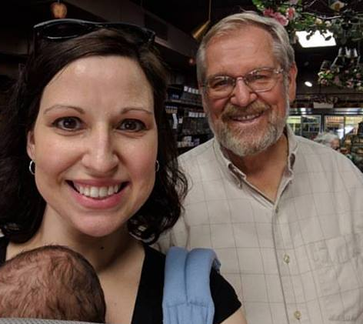

Personality & Health
Personality is defined by it’s stability
Can you change your personality?
  Ex: pessimism, hostility
“If you want to be somebody else, change your mind”
-Sister Hazel song from ‘00
But how? Through coping, support & therapy

Slide 15
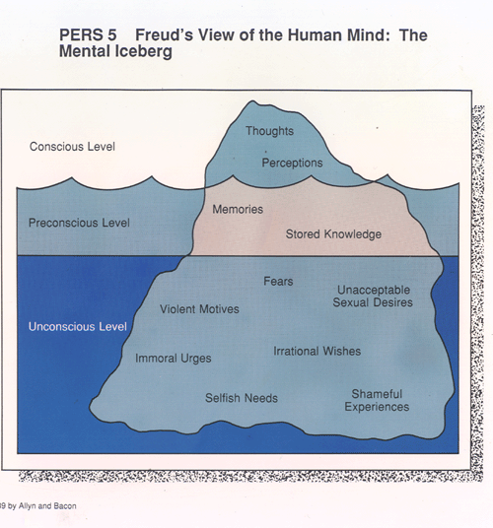
Multiple Psych Perspectives
1st Wave – Psychoanalytic
  Need to discover & address the deep,
  root causes of your problems
2nd Wave – Cognitive Behavioral Therapy
  Your thoughts & behavior are problematic, so let’s practice changing them
  Use relaxation techniques to gain control
3rd Wave – Acceptance Therapy
  We all have negative thoughts. The problem is paying too much attention to them
  Use mindfulness & other techniques to control attention
You don’t have to know these distinctions for the exam – I’m trying to give context to these different techniques

Slide 16
2nd Wave: Problematic Thoughts
Cognitive Factors
  “Cognitive triad” (Beck)→ Errors in logic
    Blame self excessively I’m a loser
    See situations as hopeless The world is unfair
    Perceive the future as bleak The future is hopeless
  “Learned Helplessness” (Seligman)
    remember the study with groups of dogs being shocked?
  “Rumination” (Nolen-Hoeksema)
    Brooding over problems
    Obsessive, intrusive thoughts

Slide 17
How to change?
Cognitive Therapy = techniques designed to change thoughts that will affect behavior
  Premise is that irrational thoughts cause problems
  If you can change someone’s APPRAISAL of events through cognitive reframing, their emotional and physiological responses may change, too
  People catastrophize and overgeneralize their misery, making it worse
  Therapists attack irrational beliefs to reframe or make them more rational
    Ex: your roommate isn’t trying to provoke you by leaving a mess
    Ex: you shouldn’t assume that the worst has happened until you know

Slide 18
Behavioral Techniques
Cognitive Behavioral Therapy (CBT)
  Behavior Modification = process of shaping behavior through operant conditioning
    Used for stress if caused by specific behavior
      Ex: Always running late…
    Principle is that behaviors that are rewarded continue, and behaviors that aren’t decrease
      Ex: complain about problems → rewarded with attention & sympathy – makes it difficult to change the stressful situation
    Identify positive reinforcers of pain/stress and reduce them, or find alternate reinforcers to reward more desirable behaviors

Slide 19
CBT
Cognitive Behavioral Therapy (CBT) combines behavior modification + cognitive therapy
  Research supports effect on stress reduction
  May also benefit immune function

Slide 20

3rd Wave Techniques
1990s – Mindfulness meditation
  Non-religious, but taken from Buddhist practice
  Don’t ignore unpleasant thoughts or sensations
  Focus on any thoughts or sensations as they occur
  Trying to focus on perceptions and thought processes w/o being judgmental
    Ex: The raisin fruit snack mindfulness meditation exercise
Guided imagery
  Think of a calm, peaceful image like the ocean or a sunflower
  Concentrate on the image – focus on it to block out or reduce focus on negative thoughts & experiences
  http://www.mckinley.illinois.edu/units/health_ed/stress_audio/beach_txt.html
Acceptance & Commitment Therapy (ACT)
Apparently I’m not the only one who struggles with these practices. Here’s some meditation humor (uses swear words, so don’t click if that offends you)
https://www.youtube.com/watch?v=92i5m3tV5XY

Slide 21
Put your stress square on your finger tip OR press your finger on the square:
Stress Square
Hold your finger on the square for 10 seconds to measure your stress level
Black = Tense ~79°
Red = Nervous ~84°
Green = Calm ~87°
Blue = Relaxed ~91°

Slide 22
REVIEW for EXAM 1
ALL my slides are posted on Bb
The following call attention to major themes & mechanisms, but these aren’t the only topics that are important for the exam

Slide 23
We started with…
Definitions: What is stress?
Models of stress
  Cannon’s Fight or Flight
  Taylor’s Tend & Befriend
  Selye’s General Adaptation Syndrome
  Lazarus & Folkman’s Transactive Model of Appraisals
What causes stress?
  Cataclysmic / catastrophic events
  Stressful life events
  Daily hassles
How do you measure stress?
  Event characteristics
  Physiological responses
  Psychological response / perception
23

Slide 24
Appraisals Determine Whether something is “Stressful”
Cognitive Behavioral Therapy can help address irrational appraisals
If NO → No Stress
Primary Appraisal
(Does this affect me?)
If YES → Move to Secondary Appraisal
Secondary Appraisal
(Can I handle this?)
If YES → No Stress
If NO → STRESS! Will Reappraise over time
Reappraisal
(Is it a problem now?)
If NO → No More Stress
If YES →Stress Continues
What factors make people more or less likely to perceive stress?
24

Slide 25
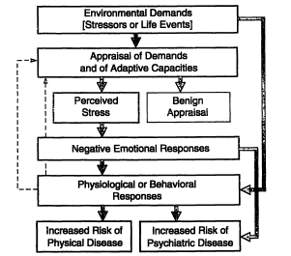
Stress has direct & indirect effects on health behavior & psych well-being
What factors can moderate or intervene?
Personality
(ex: hostility, optimism)
Control
(perceived & actual)
Social Support (perceived & received)
Resources
(ex: Status, SES)

Slide 26
The Physiology of the Stress Response
The Nervous System
The Endocrine System
The Cardiovascular System
The Immune System
Vulnerability, Coping & Resilience

Slide 27
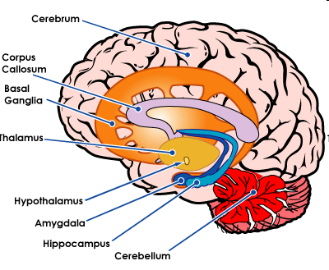
Major central nervous system components involved in the stress response
SENSORY INFO
Thalamus (relays sense info for interpretation)
Spinal cord (autonomic action starts, alertness)
Cerebral cortex (4 lobes → recognizes & makes sense of input + decision making)
Hypothalamus (4 F’s → fighting, fleeing, feeding & sex ☺)
Hippocampus (Memory & emotional baggage)
*Hypothalamus initiates additional response via the pituitary gland
Amygdala (forms emotional associations w/ sensory stimuli)

Slide 28
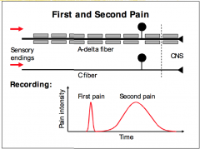
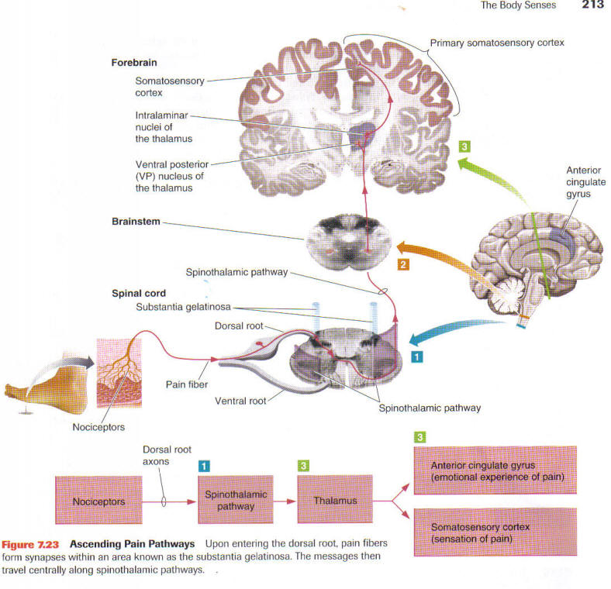
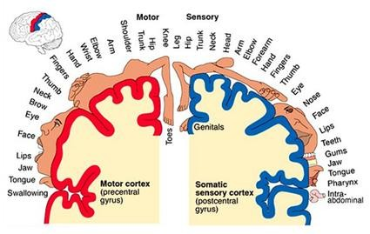
Pain Perception - Nociception
A-delta fibers = myelinated fibers – transmit sharp, brief pain rapidly
C-fibers = unmyelinated fibers – transmit slow, dull, aching pain
A-delta fibers = project to thalamus & sensory areas of the cerebral cortex → sensory experience of pain
C-fibers =project to thalamus, hypothalamus, & cortex → motivational & emotional experience of pain
Painful stimuli activate nociceptors
Modulation of pain can happen in the ascending or descending pathways

Slide 29
Physiology of the Stress Response
Start with perception of stress
→ activates the Sympathetic Nervous System
→ mobilizes body’s resources to react through 2 routes:
  Direct activation of the Sympathetic Adrenomedullary System (SAM)(adrenal glands release epinephrine to create arousal)
  2. Separately through the Hypothalamic-Pituitary-Adrenal Axis (HPA)
Cannon’s concept of “fight-or-flight” is a preliminary version of SAM
Selye’s discoveries about the endocrine & immune consequences of stress are explained by the HPA Axis
29

Slide 30
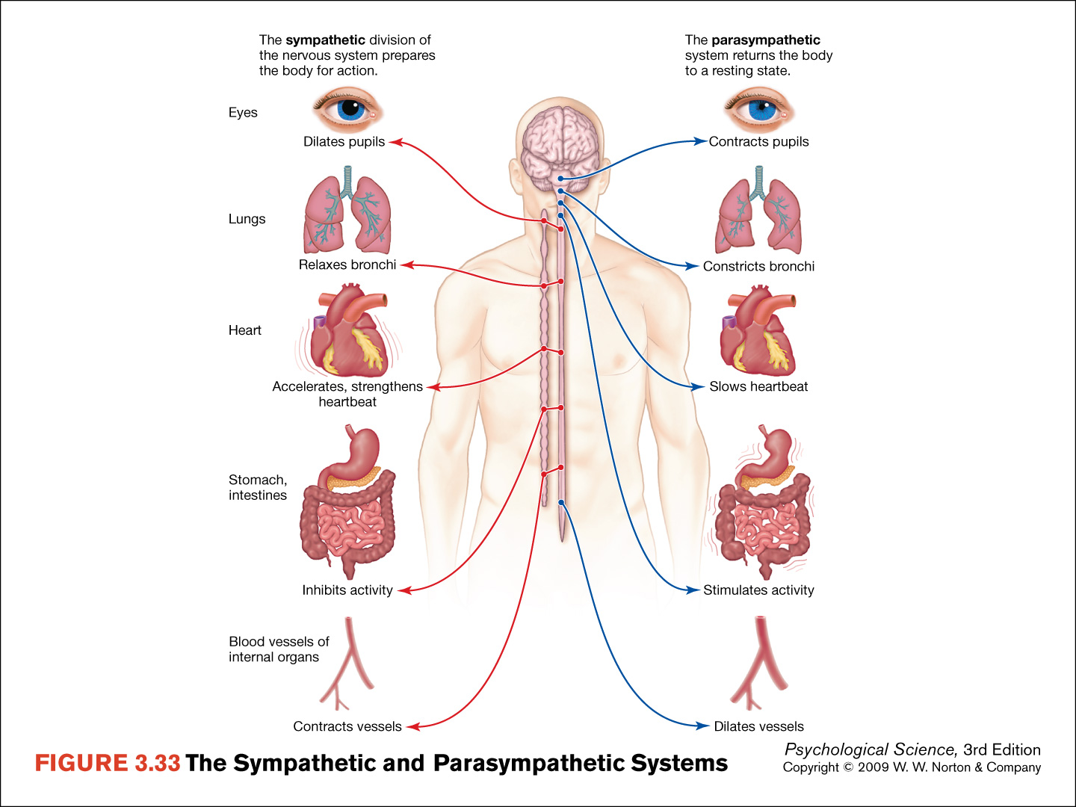
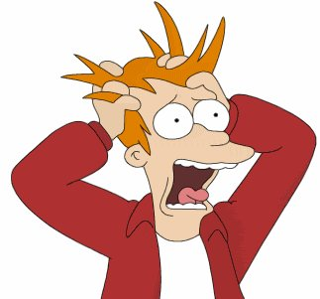
The SAM system facilitates FIGHT or FLIGHT, but these reactions are not always possible or adaptive
One alternate reaction we see is TEND & BEFRIEND
Another is FRIGHT (fainting or freezing), called “stress-related bradycardia”
HR & BP slow, and loss of consciousness may follow
How is this adaptive?

Slide 31
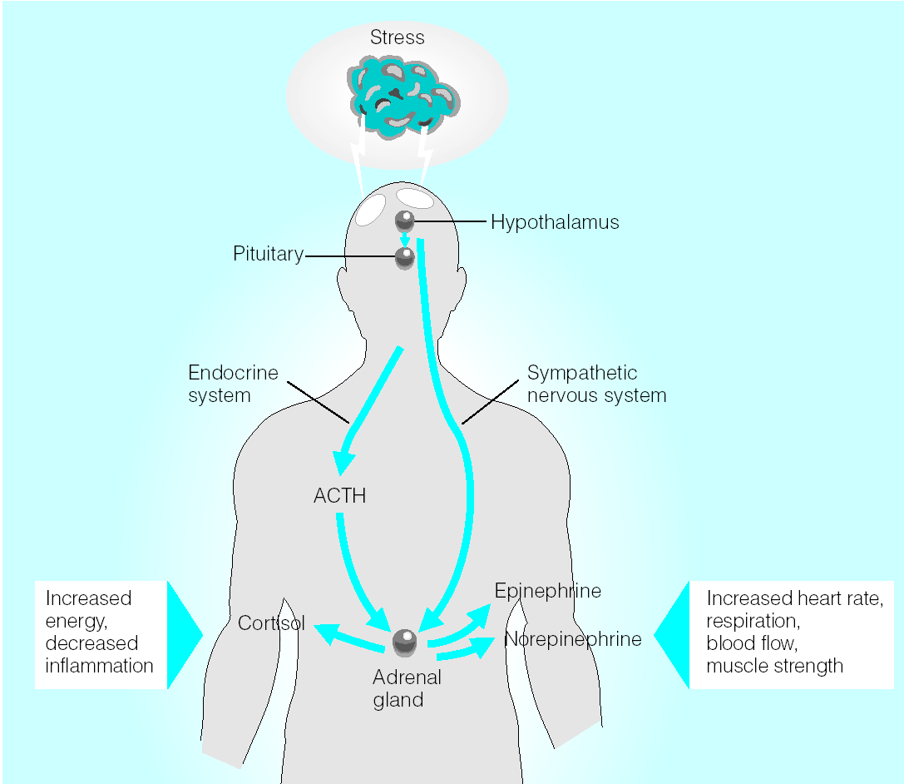
HPA Axis =
Hypothalamic
Pituitary
Adrenal
The hypothalamus stimulates the pituitary gland to secrete beta-endorphin (natural opiate) and ACTH (adrenocorticotropic hormone)
ACTH stimulates the adrenal cortex to release glucocorticoids, including cortisol
Cortisol helps liberate blood glucose & fatty acids for energy AND reduces inflammation
SAM System =
Sympathetic
Adrenal
Medullary
The SNS activates the adrenal medulla to release epinephrine and norepinephrine
These catecholamines produce the arousal necessary for fight or flight responses

Slide 32
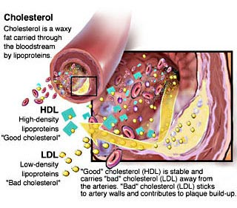
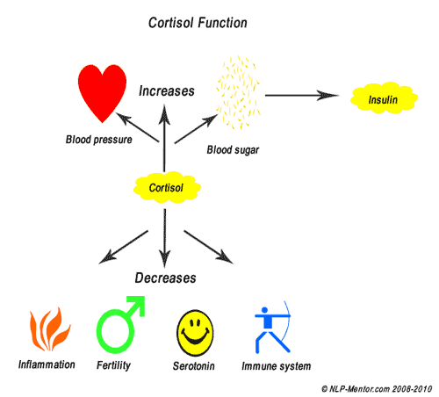
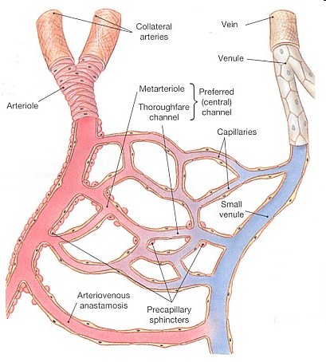
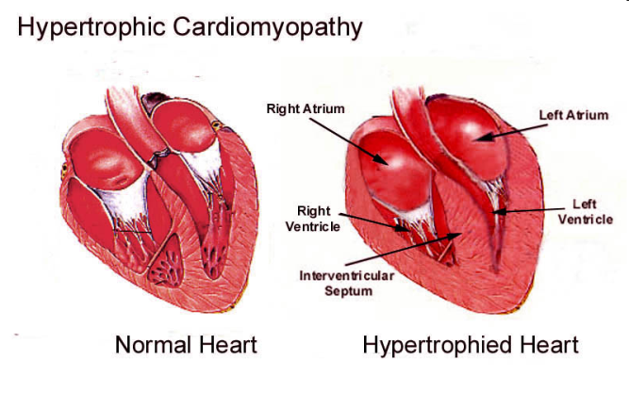
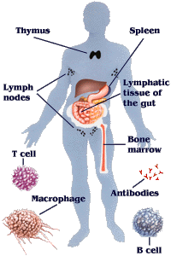
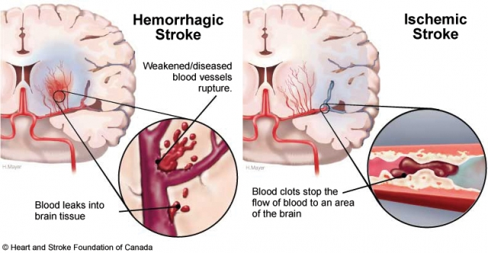
Stress has direct physiological effects on functioning as well as indirect effects on health behavior & well-being

Slide 33
Stress has direct & indirect effects on health behavior & psych well-being
What factors can moderate or intervene?
Personality
(ex: hostility, optimism)
Control
(perceived & actual)
Resources
(ex: Status, SES)
Social Support (perceived & received)

Slide 34
Mechanisms Linking Personality & Health
Positive States (ex: optimism, pos affect, control)
Stress
(actual / perceived)
Coping Strategies
Personality
Social Support
Health
Health Habits
Negative States
(ex: neuroticism, hostility, pessimism, lacking control)
Physio Reactions
Self-Report Factors

Slide 35

Social Support Mechanisms
Stress Appraisal
Cardio Functioning
Neuroendocrine Functioning
Immune Functioning
Social Support
Coping
Health Outcomes
Main types of social support:
Emotional, Instrumental/ Tangible, Informational, Belongingness, Esteem
Health Behaviors
Direct effects vs. Stress-Buffering
How are the predictions different?
How do you get & utilize more / better support?
What does it feel like to ask for / be asked for help?

Slide 36
Coping Strategies
Problem-Focused Coping vs.
Emotion-Focused Coping
Approach coping
vs.
Avoidance coping
Self-distraction
Active coping
Denial
Substance use
Use of emotional support
Use of instrumental support
Behavioral disengagement
Venting
Positive reframing
Planning
Humor
Acceptance
Religion
Self-blame
Additional factors:
Post-traumatic growth / benefit finding, perceived control, religion, status, social support, personality

Slide 37
Types of Treatments
Medicine / Surgery
Exercise / Physical Therapy
Hypnosis
Complementary & Alternative Medicine
  Massage, Acupuncture, Chiropractic Care, Tai Chi, Yoga
Distraction
Humor
Emotional Expression
Biofeedback
Relaxation Techniques
  “The Restorative Value of Nature”
  Progressive Muscle Relaxation
  Meditation
Systematic Desensitization / Exposure Therapy
Cognitive Behavioral Therapy
3rd Wave techniques
  Mindfulness Meditation
  Guided Imagery

Slide 38

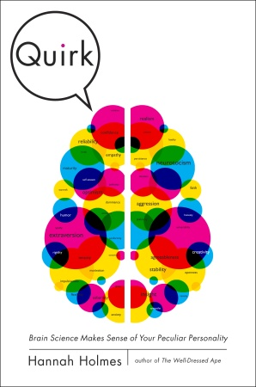
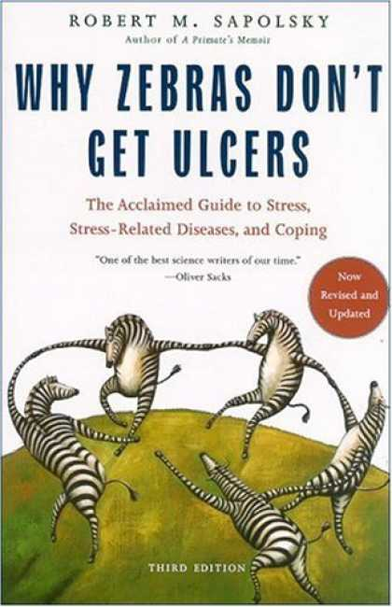
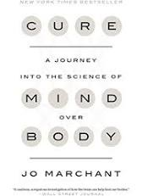

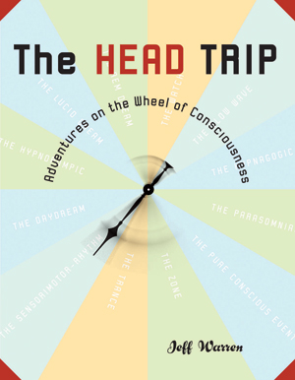

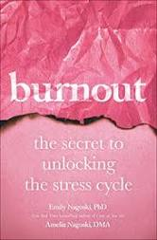

If you’re interested, there are lots of great books on the topics we’ve discussed in the Stress & Coping section of class. I’m always happy to discuss these & other recommendations with you.

Slide 39
Reminders
Exam on Tuesday! We will start ON TIME at 11:10 or 2:20) to make sure you have the ENTIRE class period
  Email me if you have questions as you study
I’ll ask you to S P R E A D O U T
No talking / no phones out (obvi)
You can write with pen or pencil – LEGIBLY, please!
If you have clarification or thesaurus q’s during the exam, you’ll raise your hand to ask
If you think a q has 2 correct answers, pick one, but also write out the reason why the other is correct

